Slide 1
Provide Insights for Telengana Government Toursim Department

Slide 2
Problem Statement Data
Telangana is one of India’s leading states and has published its tourism data under its open data policy.
As a data analyst, Peter Pandey saw this as an opportunity to expand his skills and show his work on a bigger scale. Peter Pandey’s idea is to find the patterns in the given data, do additional research, and give data-informed recommendations to the Telangana government which can be used to increase their revenue by improving administrative operations.
Two csv files domestic visitors and foreign visitors. Both the data sources containing the following fields:
District: The name of district in telengana
Date: The starting date of the month when the tourists data was collected for specific district
Month: The month for which tourist data is being reported
Year: The year in YYYY format
Visitors: The number of domestic visitors who visited the given district in telengana during specified month and year

Slide 3
Technologies used
Python -- Used pandas merging and joining domestic, foreign visitors data and other useful data. Data cleaning, transformation, performing EDA are all done with pandas. Used seaborn and matplotlib for data visualization. Used BeautifulSoup4 for scraping data from Telangana website for the purpose extracting population data.
Sql – Used for querying and manipulating data to answer all important questions.
PowerBi Used for data visualization, calculating all important metrics through dax measures, data modelling and data transformation

Slide 4
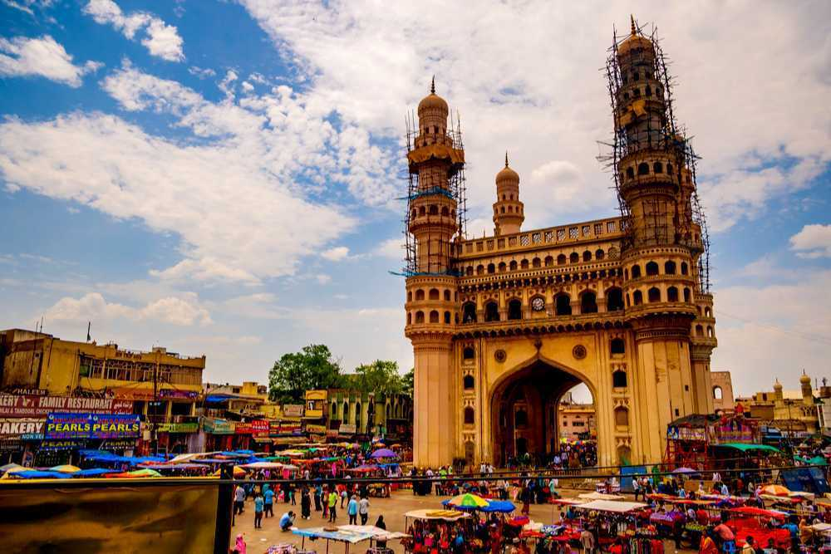
About Telengana
Telangana is a landlocked state in India situated in Southern part of the Indian peninsula on the high Deccan Plateau. It is the eleventh-largest state and the twelfth-most populated state in India as per 2011 census. On 2 June 2014, the area was separated from the northwestern part of Andhra Pradesh as the newly formed state of Telangana, with Hyderabad as its capital.
The economy of Telangana is the ninth-largest in India, with a gross state domestic product (GSDP) of ₹9,572,071 million (equivalent to ₹11 trillion or US$140 billion in 2023) and has GSDP per capita of ₹320,000 (US$4,000). Telangana has scored 0.705 human development index.
The state has emerged as a major focus for robust IT software, industry and services sector. The state is also the main administrative center of many Indian defence aerospace and research labs like Bharat Dynamics Limited, Defence Metallurgical Research Laboratory, Defense Research and Development Organization and Defence Research and Development Laboratory.

Slide 5
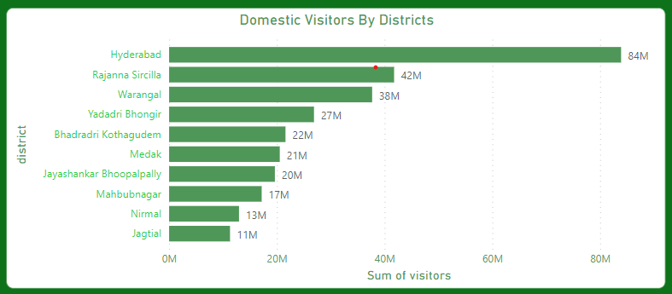
Q. List down top 10 districts that have highest number of domestic visitors overall
Insights
Hyderabad has most number of domestic visitors . Reasons:-
Historical Significance: Hyderabad has a rich historical heritage, with landmarks such as the Charminar, Golconda Fort, and Qutub Shahi Tombs. These attractions draw history enthusiasts and tourists interested in exploring the city's cultural past.
Parks and Recreation: Hyderabad boasts beautiful parks and recreational spaces, such as the Necklace Road and Hussain Sagar Lake, providing residents and tourists with opportunities for leisure and relaxation.
Cultural Events and Festivals: The city hosts various cultural events and festivals throughout the year, drawing crowds from different parts of the country. These events showcase the city's vibrant cultural scene.

Slide 6
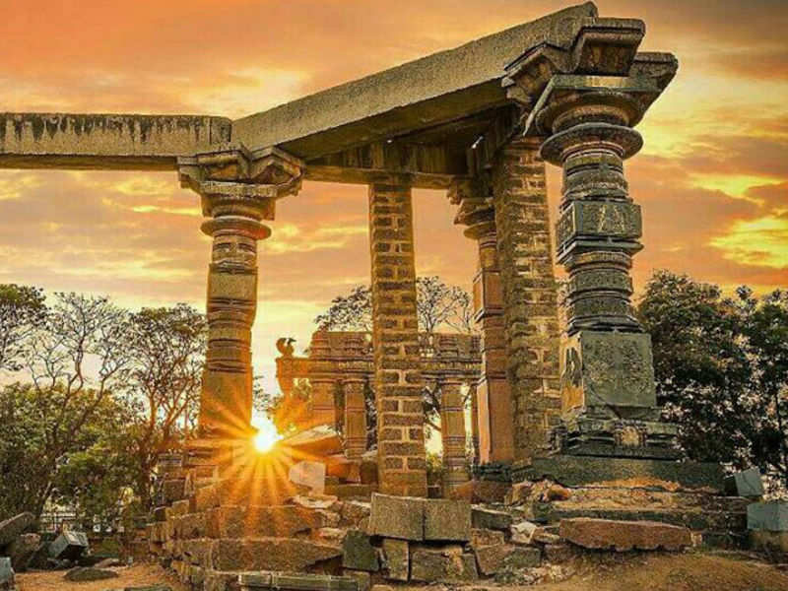
Rajanna Sircilla in telengana is a popular district due to its rich cultural heritage, historical significance and picturesque landscapes. Visitors are drawn to its ancient to its ancient temples, traditional handicrafts and renowned handloom industry,offering a glimpse into the region’s vibrant culture and traditions
Warangal in Telengana, is a popular tourist destination due to its rich historical and architectural heritage. It is home to iconic landmarks like the Warangal Fort and Thousand Pillar Temple, which showcase the region’s cultural and artistic excellence, attracting visitors across the globe.

Slide 7
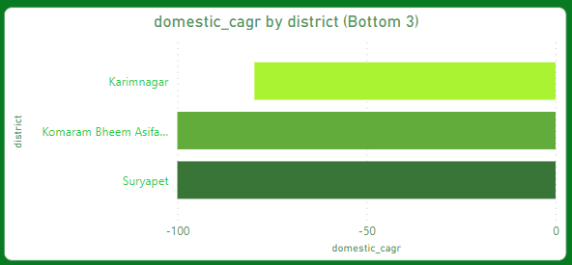
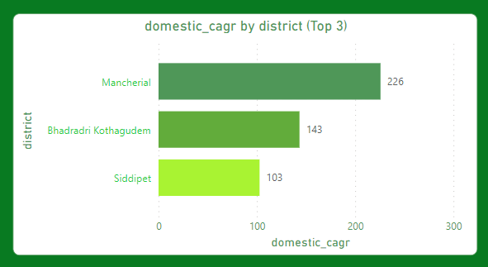
Q. List down the Top 3 and Bottom 3 districts based on Compound Annual Growth Rate (CAGR) of visitors between (2016-2019)

Slide 8
Insights: 1. Mancherail district in Telengana has the highest Compound Annual Growth Rate (CAGR) that is 226% due to its factors such as favorable government policies, industrial development, infrastructure development, infrastructure investments, strategic location , and a conducive business environment attracting investments and fostering economic growth. 2. Karimnagar has the lowest CAGR due to its factors such as limited infrastructure development, inadequate promotion and marketing efforts, lack of tourist attraction, and insufficient investments in tourism-related activities.
Recommendations:
1. To increase the CAGR in districts with low growth in tourism, the government should focus on improving infrastructure, promoting unique cultural and historical sites, enhancing marketing efforts through digital platforms, collaborating with travel agencies and offering attractive packages to attract tourists.

Slide 9
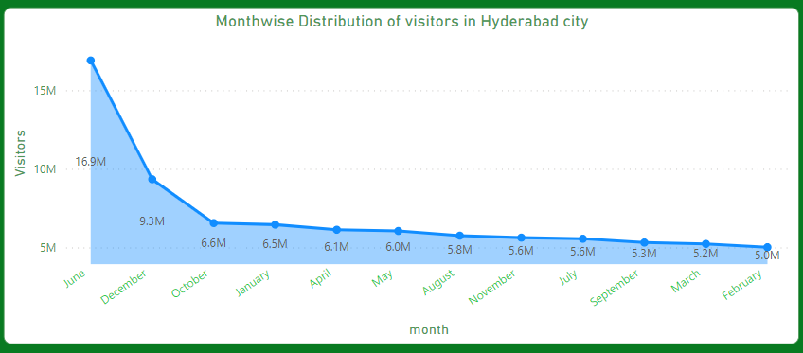
Q. What are peak and low season months for Hyderabad based on data for 2016 to 2019
Insights:
June in Hyderabad has the maximum number of visitors (17 Million) due to pleasant weather conditions, popular events like the Bonalu Festival, and summer vacations, attracting tourists and locals alike.
Recommendations:
For Low season months, the governments can offer discounted packages, promote unique cultural experiences, collaborate with travel agencies for attractive deals, host special events and festivals, leverage digital marketing and social media, improve infrastructure, and enhance hospitality services.
The government can plan well for high season tourism in Hyderabad by conducting market research, promoting attractions, improving infrastructure, coordinating with stakeholders, and implementing effective marketing and communication strategies.

Slide 10
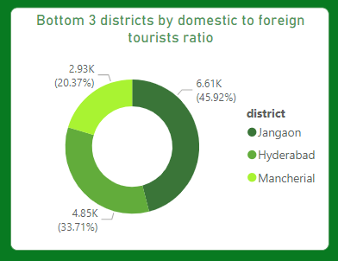
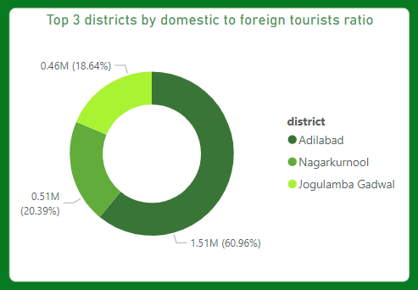
High domestic to foreign ratio – More domestic visitors Low domestic to foreign ratio – More foreign visitors The government should focus on reducing the domestic to foreign tourists ratio, since foreign tourists brings in more revenue To promote foreign tourists in Hyderabad, government should focus on enhancing cultural experiences, organinzing international events, improving infrastructure, increase in marketing efforts, offering language support and providing personalized travelling packages.
Q. Show bottom 3 and top 3 districts by domestic to foreign tourists ratio

Slide 11
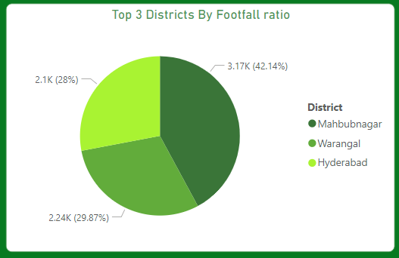
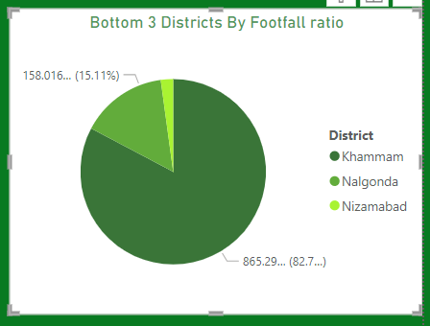
Q. List the top and bottom 5 districts on “Population to Tourists footfall ratio” in the year 2019
Population to tourists footfall ratio = Total visitors/ Total Residents population
A high population to tourist footfall ratio suggests a lower level of tourism relative to the population, while a low ratio indicates a high level of tourism relative to the population
Insights & Recommendations:
Rangareddy, Peddapalli and Nizamabad have very low population to tourist footfall ratio. To improve this the tourism government of Telengana should improve infrastructure, promote local attractions, enhance transportations options, collaborating with travel agencies create enganing market campions, and encouraging community.

Slide 12
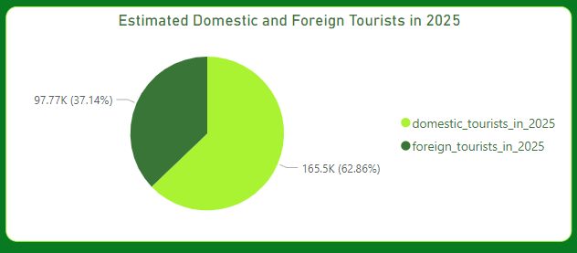
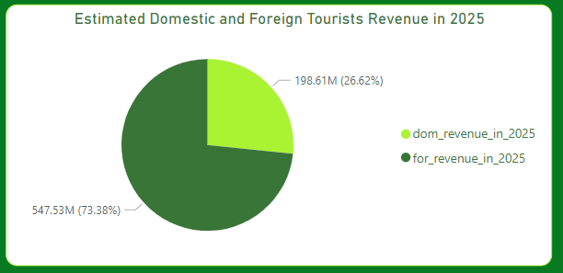
Q. What will be the projected number of domestic and foreign toursists and revenue in Hyderabad in 2025 based on the growth rate of previous years?
Estimate domestic visitors in 2025 → 165.5K
Estimate foreign visitors in 2025 → 97.77K
Estimate revenue from domestic visitors in 2025 → 198.61M
Estimate revenue from foreign visitors in 2025 → 547.53M
Average revenue generated per tourists from foreign tourists is almost 5 times the Average revenue generated per tourists from domestic tourists. Hence the estimated revenue from foreign tourists is much more than estimated revenue from domestic tourists

Slide 13
INSIGHTS:
Hyderabad has become more attractive to foreign tourists, potentially due to factors such as improved international connectivity or increased marketing efforts.
• However, the declining number of domestic tourists suggests a need to understand and address potential challenges in domestic tourism promotion or local preferences.
• Increasing foreign tourists in the future indicate increased revenue for the district.
RECOMMENDATIONS:
To accommodate the projected increase in foreign tourists, the government should focus on :
1. expanding tourism infrastructure,
2.improving transportation networks,
3. enhancing visa processes,
4. promoting cultural exchange programs,
5. implementing sustainable tourism practices,
6. prioritizing safety and security measures.
7. Collaboration with local communities and tourism stakeholders is crucial for effective implementation

Slide 14
Steps to be taken by Government to increase tourism
To enhance tourism in Telangana, the government can take several strategic steps to create a conducive environment for both domestic and international visitors. Here are some recommendations:
1. Infrastructure Development:
- Invest in improving transportation infrastructure, including roads, airports, and public transportation systems.
- Upgrade and maintain tourist-friendly facilities such as rest areas, parking lots, and information centers.
2. Promotion of Cultural and Heritage Sites:
- Develop and implement strategies to promote cultural and historical attractions through marketing campaigns.
- Provide financial support and incentives for the preservation and maintenance of heritage sites and museums.
3. Tourism Policy and Regulation:
- Formulate and implement a comprehensive tourism policy that supports the growth of the tourism sector.
- Streamline regulations and procedures to make it easier for businesses to operate in the tourism industry.
4. Investment in Tourism Infrastructure:
- Encourage private sector investment in tourism infrastructure, such as hotels, resorts, and recreational facilities.
- Provide incentives and tax breaks for businesses investing in the tourism sector.
.

Slide 15
5. Safety and Security Measures:
- Enhance safety and security measures in popular tourist destinations to build trust among visitors.
- Increase the presence of law enforcement personnel in key tourist areas.
6. Marketing and Promotion:
- Develop and execute effective marketing campaigns to promote Telangana as a tourist destination.
- Utilize digital marketing tools and social media platforms to reach a wider audience.
- Participate in travel fairs and exhibitions to showcase the state's attractions.
7. Community Involvement and Sustainable Tourism:
- Involve local communities in tourism planning and development to ensure sustainability.
- Promote responsible tourism practices that respect local cultures and the environment.
- Encourage the development of community-based tourism initiatives.
8. Information and Technology Integration:
- Implement technology solutions such as mobile apps and online platforms to provide real-time information to tourists.
- Utilize data analytics for tourism planning and to understand visitor preferences.
9. Festival and Event Sponsorship:
- Sponsor and support cultural, religious, and other events that can attract tourists.
- Host or support festivals that showcase the unique traditions and cultural richness of Telangana

Slide 16
Cultural Events to boost Tourism
1. Bonalu Festival:
- Bonalu is a traditional Telangana festival celebrated to honor the goddess Mahakali. Organizing the Bonalu festival with grand processions, traditional music, dance, and rituals can attract devotees and tourists alike.
2. Bathukamma Festival Celebrations:
- Bathukamma is a vibrant and colorful floral festival celebrated by women in Telangana. Organizing Bathukamma competitions, cultural performances, and traditional music events can draw visitors interested in the local culture.
3. Deccan Festival:
- The Deccan Festival can be organized to showcase the cultural heritage of the Deccan region. This festival can feature classical dance performances, music concerts, handicraft exhibitions, and traditional food fairs.
4. Qutb Shahi Heritage Walks:
- Organize guided heritage walks around the Qutb Shahi Tombs complex to provide tourists with insights into the history and architecture of this iconic site. Include cultural performances and storytelling sessions during the walks.
5. Telangana Formation Day Celebrations:
- Celebrate Telangana Formation Day with a series of events, including parades, cultural performances, and exhibitions highlighting the achievements and cultural diversity of the state.
6. Kakatiya Festival:
- Celebrate the legacy of the Kakatiya dynasty with a Kakatiya Festival. Include historical reenactments, traditional dance performances, and workshops on Kakatiya art and architecture.

Slide 17
Corporate Events to boost Tourism
1. Business Conferences and Seminars:
- Host industry-specific conferences and seminars in Hyderabad, focusing on key sectors such as information technology, pharmaceuticals, and biotechnology. Provide opportunities for networking and collaboration.
2. International Trade Fairs and Expos:
- Organize international trade fairs and expos, attracting businesses and professionals from around the world. Highlighting the state's economic strengths can encourage investment and tourism.
3. Technology and Innovation Summits:
- Host summits that bring together thought leaders, entrepreneurs, and innovators in the technology sector. Showcase Telangana's achievements in technology and innovation.
4. Investment Conclaves:
- Organize investment conclaves to attract potential investors to Telangana. Highlight the state's business-friendly policies, infrastructure, and growth opportunities.
5. Healthcare Conferences:
- Host conferences related to healthcare and life sciences, leveraging Telangana's reputation as a hub for the pharmaceutical and biotechnology industries. Include visits to healthcare facilities.

